Slide 1
Composite Beam Bending
ASEN 2001 Lab 3 Fall 2018

Slide 2
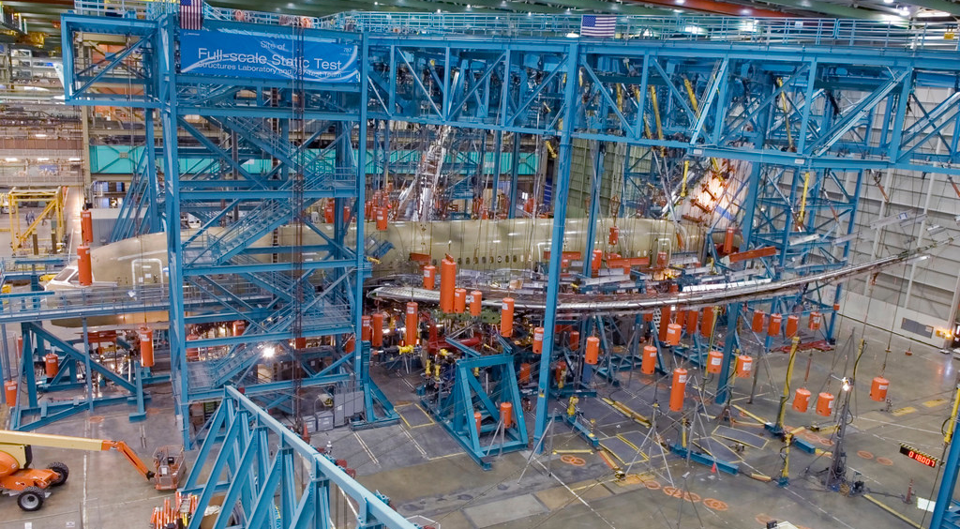
Boeing 787 – Bending test

Slide 3
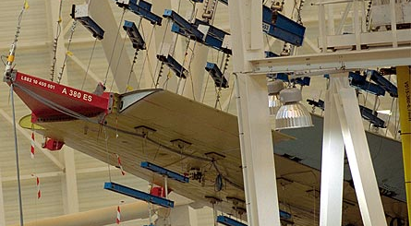
Airbus A380 wing test

Slide 4
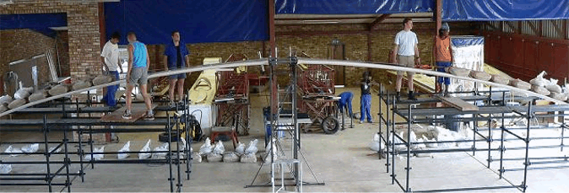
Glider wing test

Slide 5

Lab 3 Goals
Analyze, design, manufacture, and test a composite wing with maximum strength while having minimum weight subject to aerodynamic loading.
aerodynamic loading

Slide 6
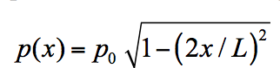
Lab 3 – A simpler set up
=36”
Plan view:
Cross section:
width
Balsa wood
Foam

Slide 7
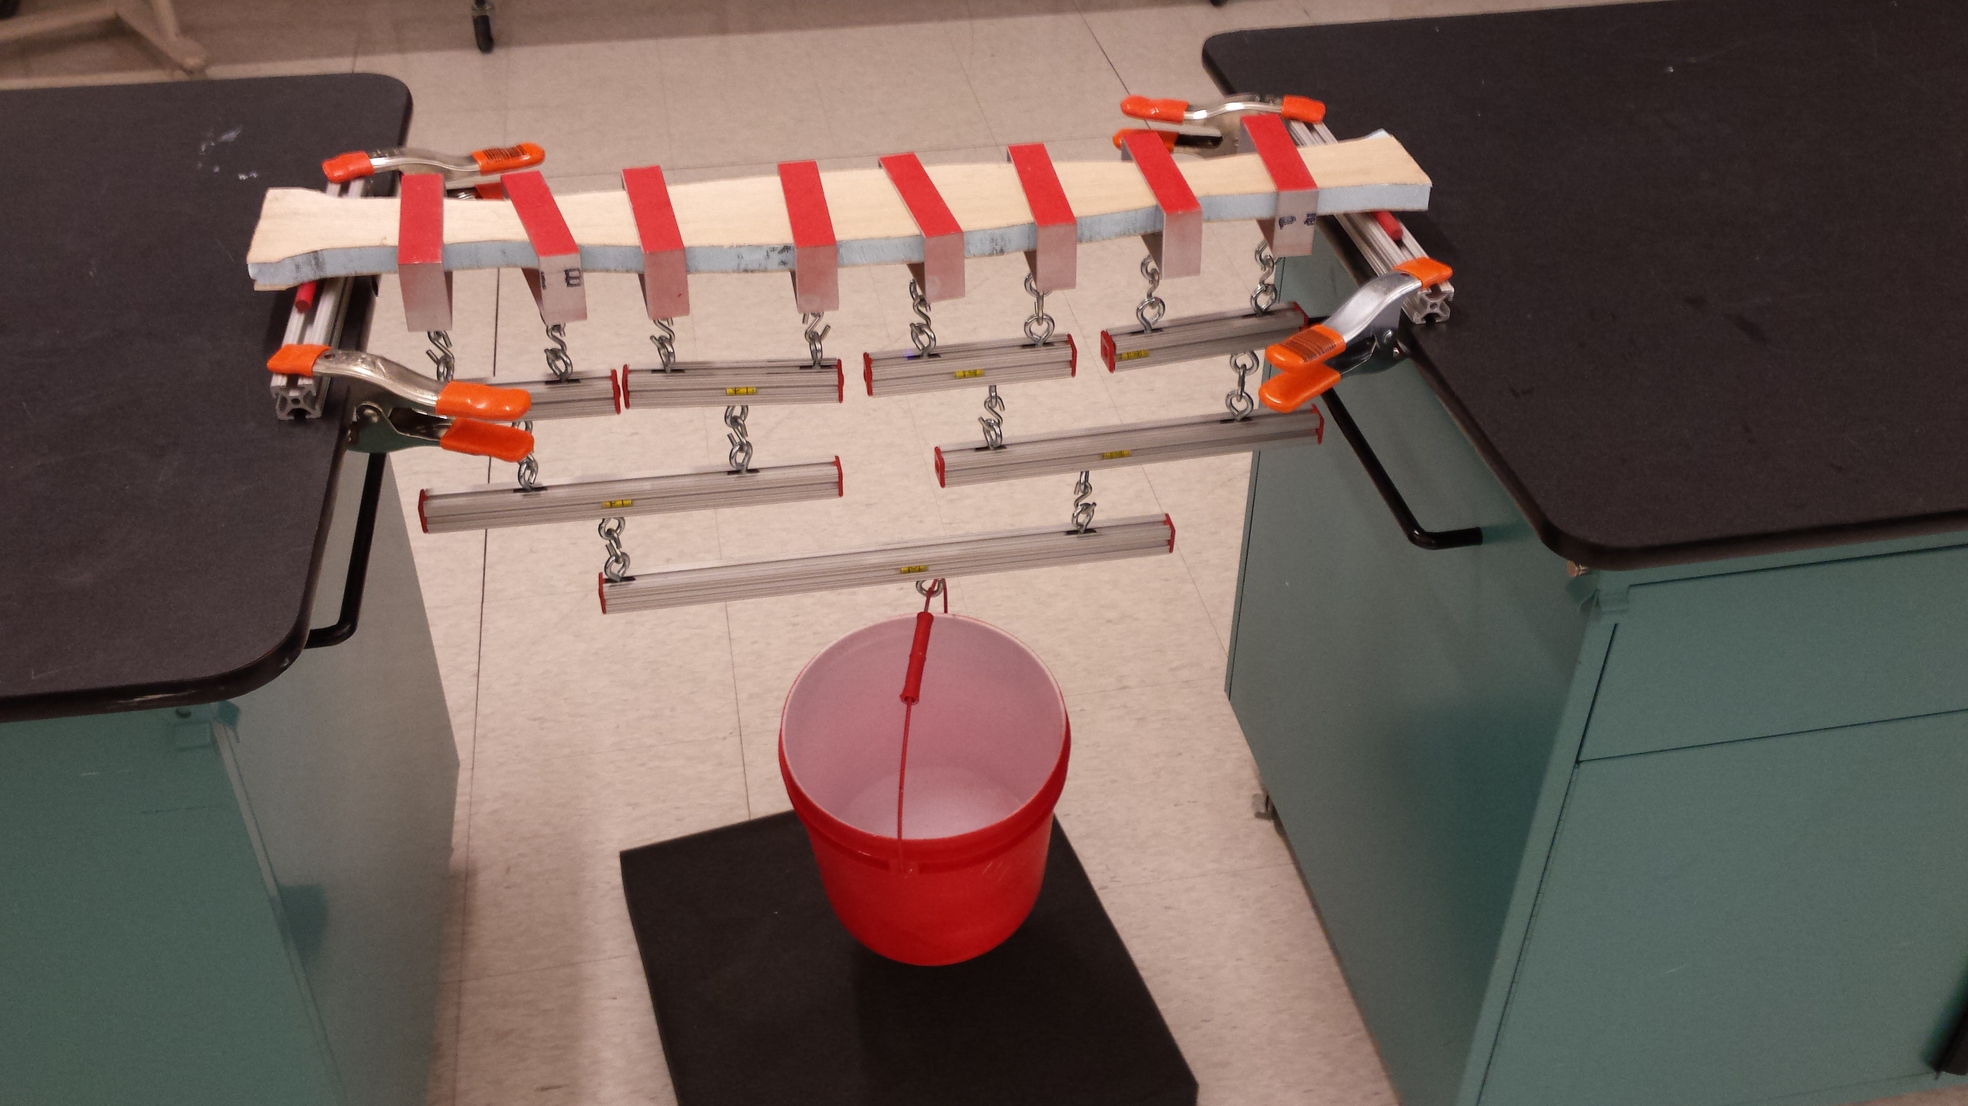
Lab 3 – How will it look like?
rod
wing
plastic strips
clamp
bucket
wiffle tree

Slide 8
Lab 3 – First identify beam strength
What is ?
What is ?
Test Data (available on Canvas) on failure of several wings under four point bending test:
Four point bending test:

Slide 9
Parameter/variable definitions
Total force on the beam at failure (see data file)
Bending moment at the failure section (under bending)
Shear force at the failure section (under shear)
Max normal stress at the failure section (under bending)
Max shear stress at the failure section (under shear)
Moment of inertia of Balsa wood and foam around the axis passing
through centroid of section
Young’s modulus of Balsa wood
Young’s modulus of foam
Area of foam cross section
Half of cross section’s total height

Slide 10
Lab 3 – First identify beam strength
Bending failure:
moment diagram
flexture formula
Test data
Flexure formula:
balsa
foam

Slide 11
Lab 3 – First identify beam strength
Shear failure:
shear diagram
shear formula
Test data
Shear formula:
foam

Slide 12
Data Analysis – Tasks for Nov 5th
Identify E_{b} (balsa) and E_{f} (foam). Refer to ModulusofElasticity.docx on Canvas.
Generate the shear and moment diagrams for each of the four point test data
For each data entry identify shear or bending failure, and exclude outliers
For each data entry compute and depending on the failure mode
Pick and and a corresponding FOS for your actual design
Write a MATLAB function to do these!

